Slide 1

Gwendal Bescont
Arinfo Saint-Nazaire 2020

Slide 2


Présentation du projet
Association Les Lames du Ponant
Expression des besoins
Réunion hebdomadaire
Veille concurrentiel

Slide 3
LES OUTILS UTILISÉS
Visual studio code
MVC Symfony
CSS Materialize
Composer
SASS
jQuery
Javascript
Documentation Symfony, Stack Overflow
Tutoriels en ligne

Slide 4
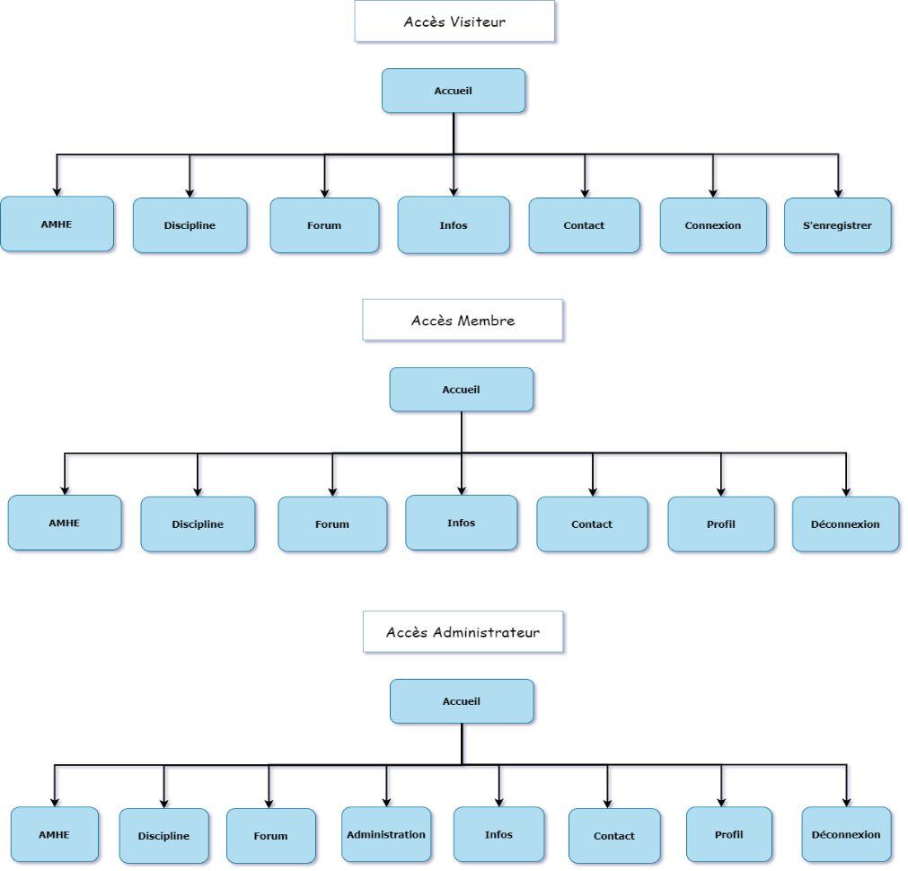

ARBORESCENCE

Slide 5
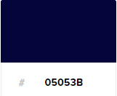

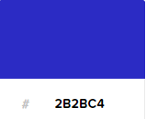

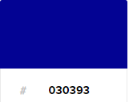
CHARTE GRAPHIQUE

Slide 6
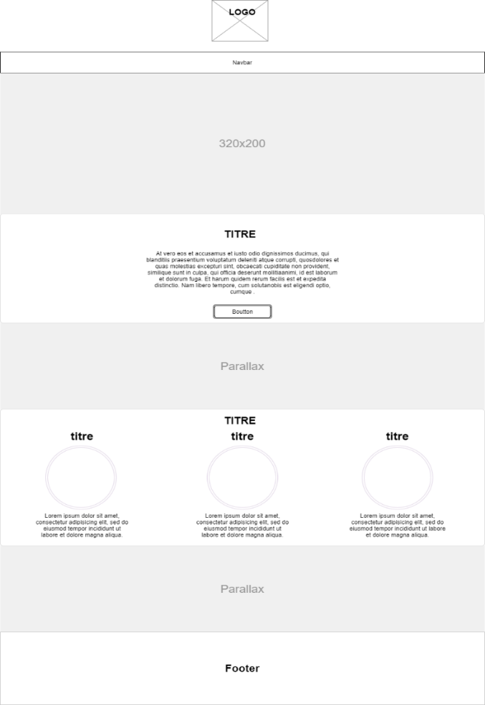
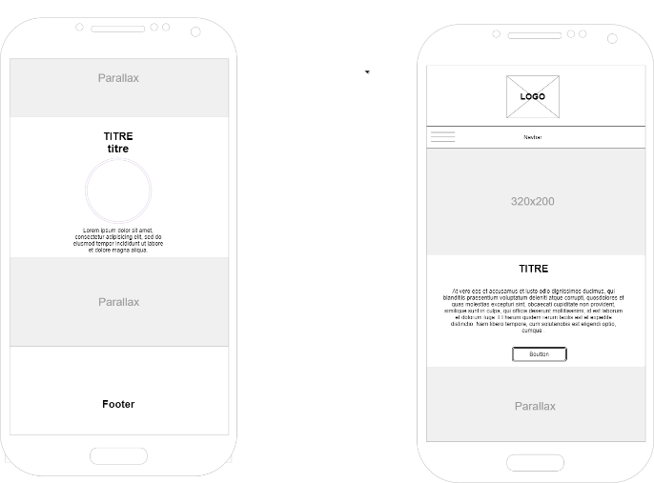
MAQUETTE WIREFRAME

Slide 7
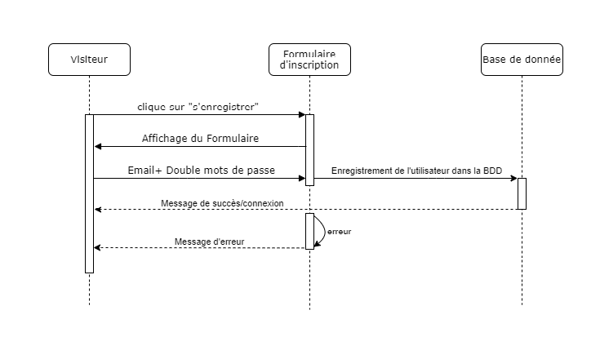
DIAGRAMME DE SEQUENCE

Slide 8
RÔLES ET SECURITE
# Easy way to control access for large sections of your site
# Note: Only the *first* access control that matches will be used
access_control:
- { path: ^/admin, roles: ROLE_ADMIN }
- { path: ^/user, roles: ROLE_USER }
role_hierarchy:
ROLE_MODERATOR: ROLE_USER
ROLE_ADMIN: ROLE_MODERATOR
ROLE_SUPER_ADMIN: [ROLE_ADMIN, ROLE_ALLOWED_TO_SWITCH]

Slide 9
CONTROLLER : LE FORUM
/**
* @Route("/categories/sujet/{slug}", name="le_forum_subject", methods={"GET","POST"})
*/
public function showMessage(
$slug,Request $request,
SubjectForum $subjectForum,
CategoryForumRepository $categoryForumRepository,

Slide 10
CONTROLLER : FORUM REQUÊTE
$subjectForum=$this->getDoctrine()->getRepository(SubjectForum::class)fidOneBy(['slug'=> $slug]);
$messageForum=$this->getDoctrine()->getRepository(MessageForum::class)
->findBy([
'subjectMessageForum'=> $subjectForum,
'active'=> 1,
],['datePublicationMessageForum'=>'DESC’]);

Slide 11
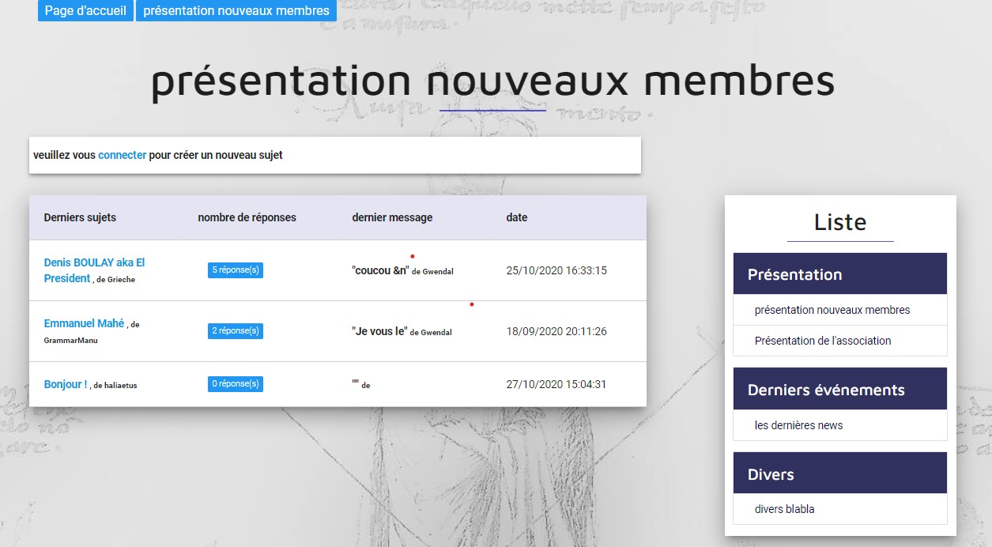

Slide 12
CONTROLLER : FORUM FORMULAIRE
$messageForum = new MessageForum();
$messageForum->setUser($this->getUser());
$messageForum->setActive(true);
$messageForum->setSubjectMessageForum($subjectForum);
$form = $this->createForm(MessageForumType::class, $messageForum);
$form->add('submit', SubmitType::class, [
'label' => 'envoyer',
'attr' => ['class' => 'btn btn-default pull-right'],
]);
$form->handleRequest($request);

Slide 13
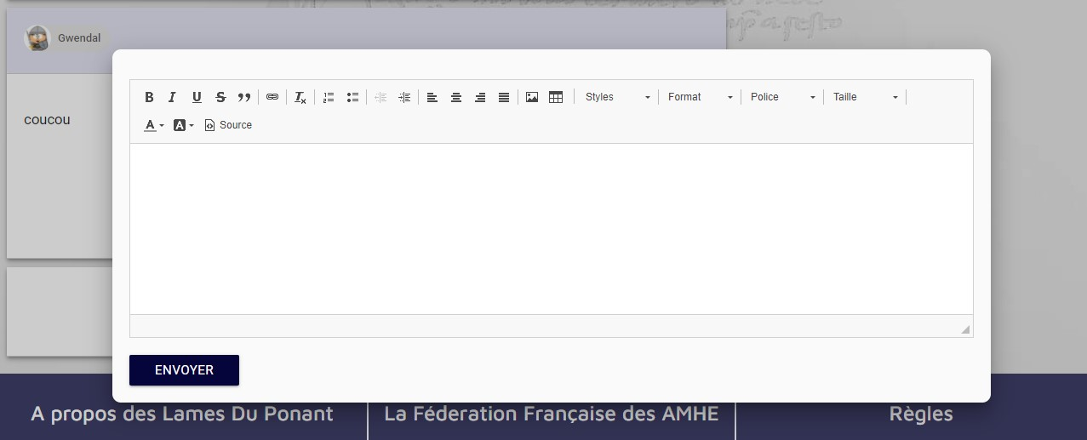

Slide 14
VALIDATION DU FORMULAIRE ET REDIRECTION
if ($form->isSubmitted()&& $form->isValid()) {
$entityManager = $this->getDoctrine()->getManager();
$entityManager->persist($messageForum);
$entityManager->flush();
return $this->redirectToRoute('le_forum_subject',['slug'=> $slug]);
}

Slide 15
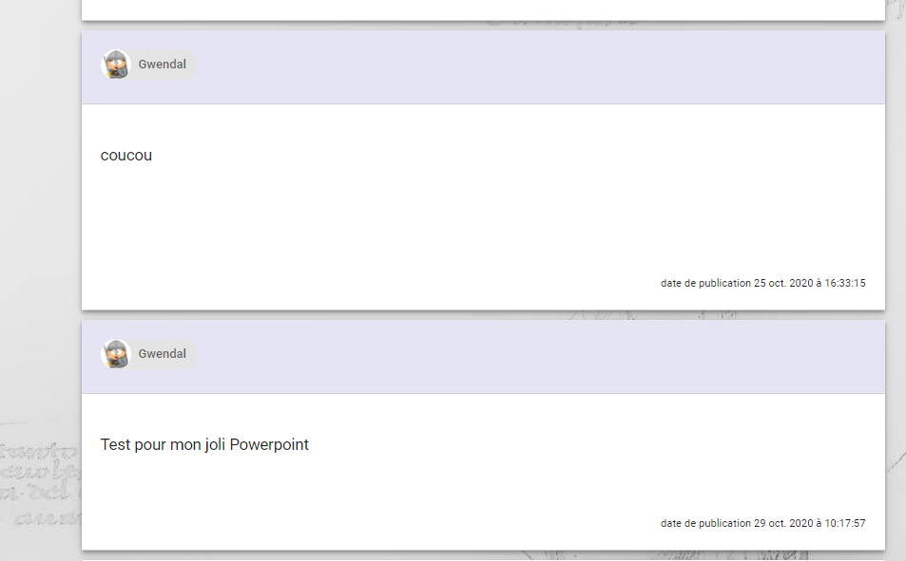

Slide 16
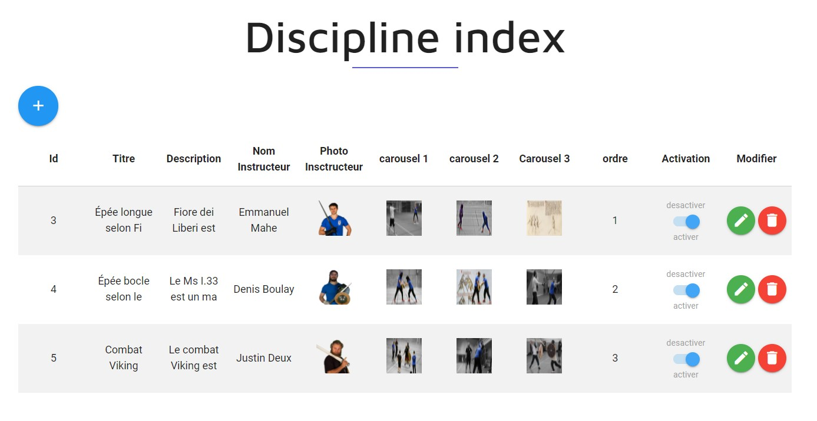
CRÉER UNE INTERFACE AVEC GESTION DE CONTENU

Slide 17
REQUÊTE AJAX
<script>
window.onload = () => {
let activer = document.querySelectrAll("[type=checkbox]")
for (let bouton of activer) {
bouton.addEventListener("click", function () {
let xmlhttp = new XMLHttpRequest;
xmlhttp.open("get", `/admin/category/forum/actver/${this.datset.id}`)
xmlhttp.send()
})
}

Slide 18
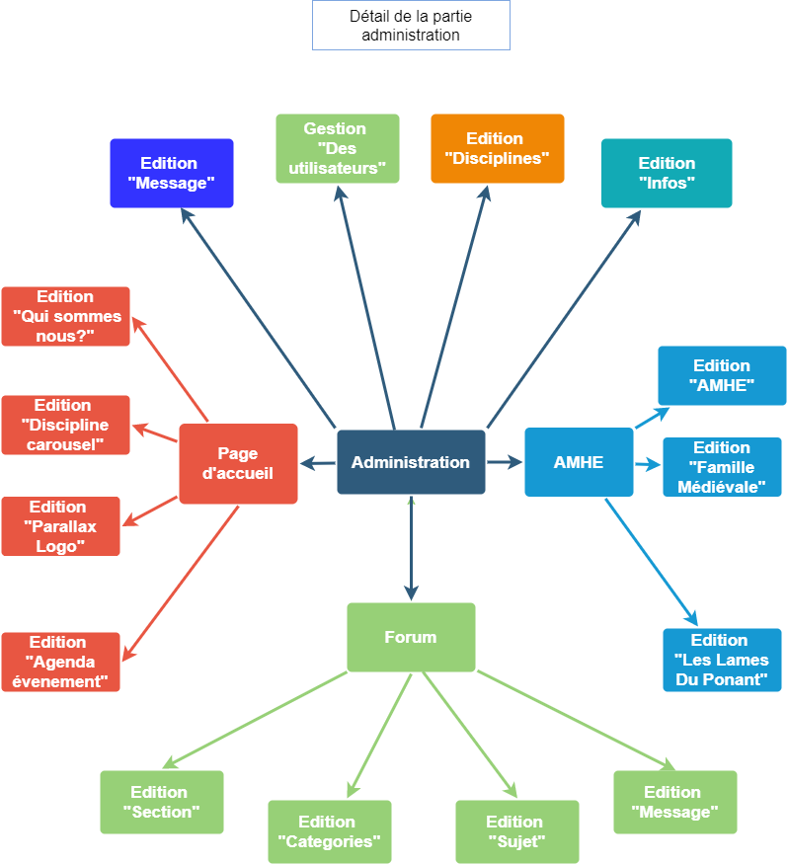

Slide 19
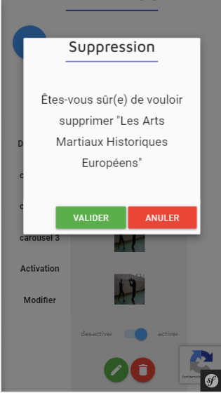
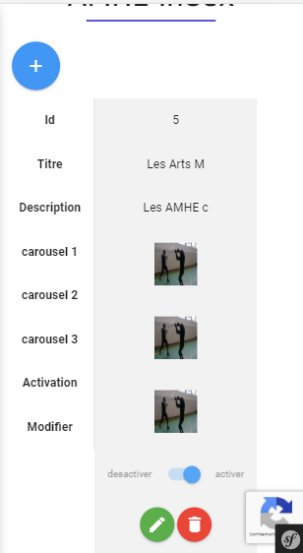
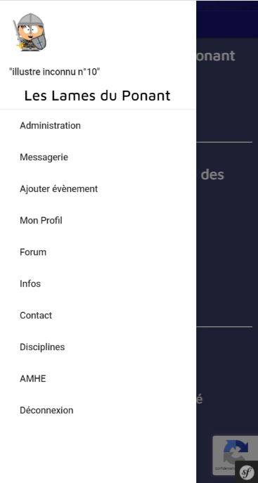
RESPONSIVE
<div class="col xl3 offset-xl1 l3 offset-l1 m12 s12 z-depth-5 liste-forum">

Slide 20


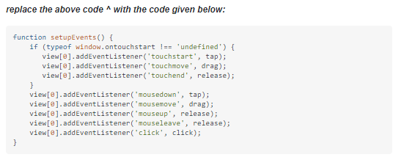
LA RECHERCHE EN ANGLAIS

Slide 21
DEMONSTRATION

Slide 22
SYNTHÈSE

